Slide 1
Fitness Subcommittee Report
September 24, 2020 P&E Meeting

Slide 2
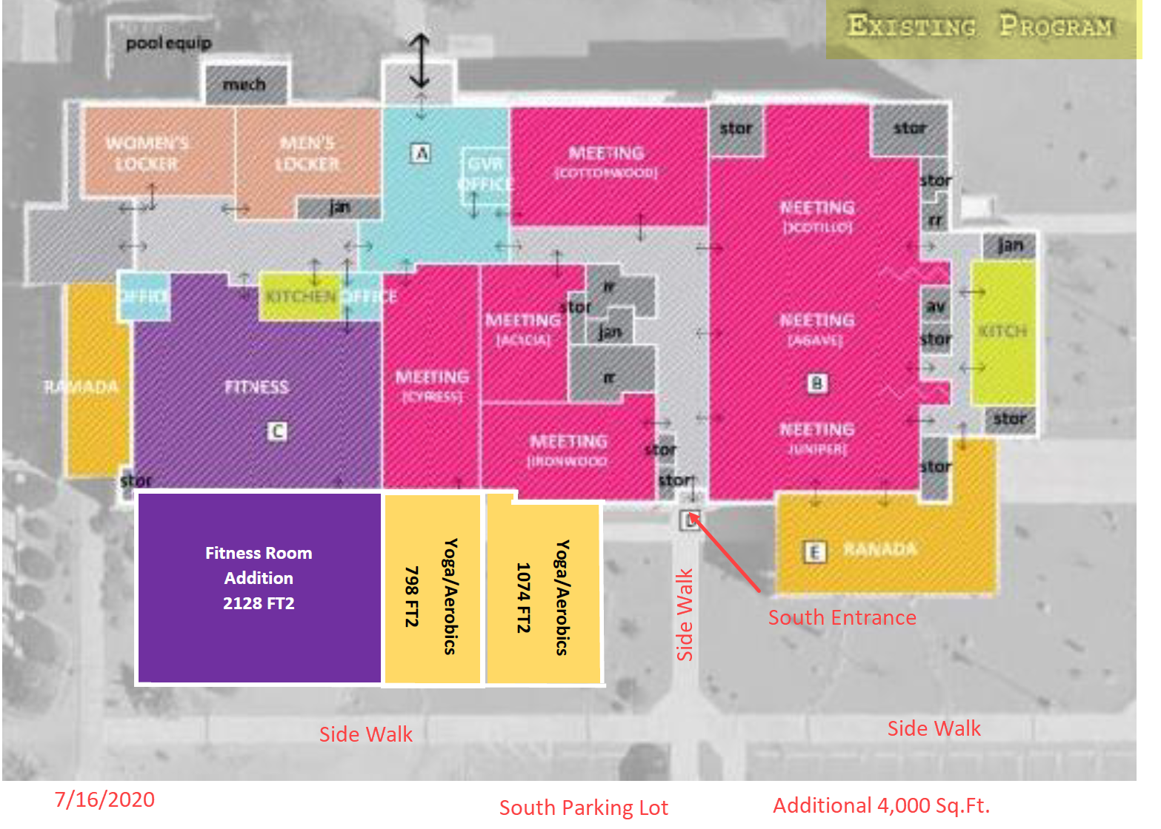

Slide 3
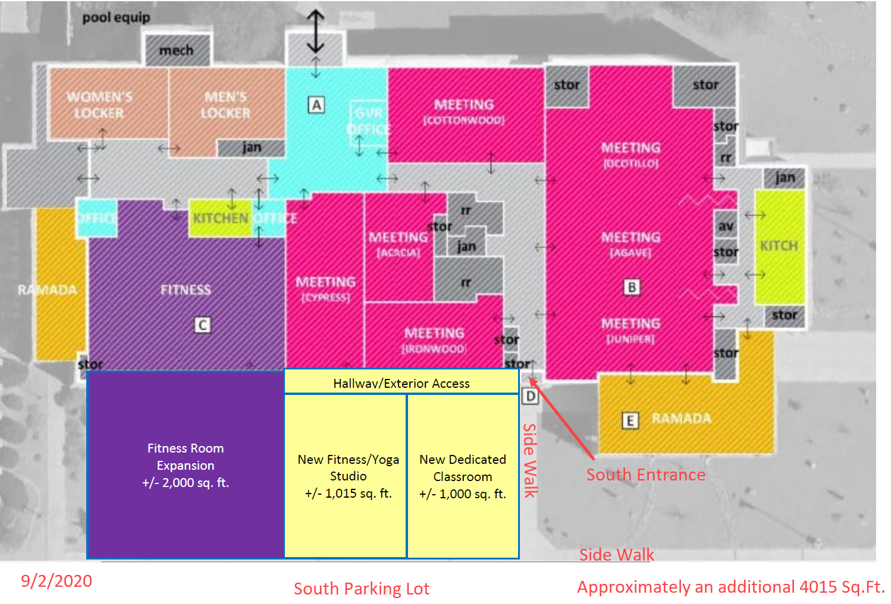

Slide 4
